Slide 1
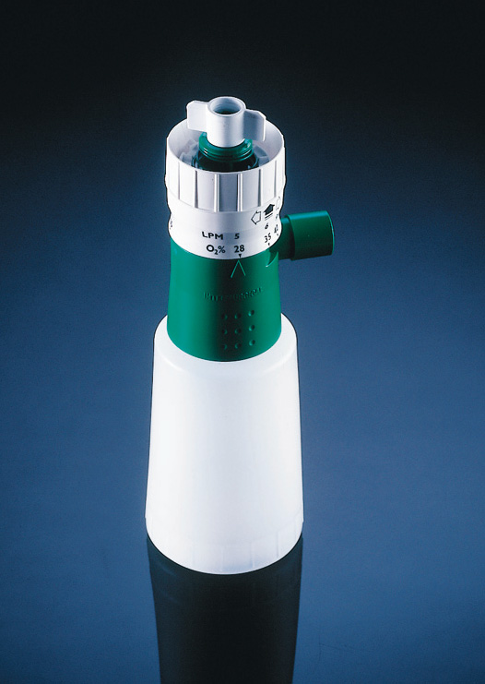
AquaMist Humidifier Nebuliser
Geoff Wond

Slide 2
What is it for?
The AquaMist is designed for delivering accurate concentrations of humidified air/oxygen mixtures, quietly.

Slide 3
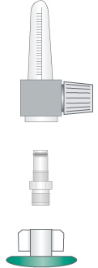
How does it work?
It may be attached to the majority of oxygen flow meters via a universal thread fitting or an adapter

Slide 4
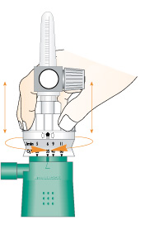
How does it work?
Concentration of oxygen is
selected by lifting and turning the top of the nebuliser and aligning the required oxygen percentage with the arrow.

Slide 5
How does it work?
On the AquaMist top there is an indication of the oxygen flow rate required for each oxygen concentration setting.

Slide 6
Accurate delivered oxygen concentrations
O2 l/min | %O2 | L/ min | G/min H20
5 | 28 | 55 | 0.42
6 | 35 | 34 | 0.41
9 | 40 | 37 | 0.53
11 | 60 | 22 | 0.50

Slide 7
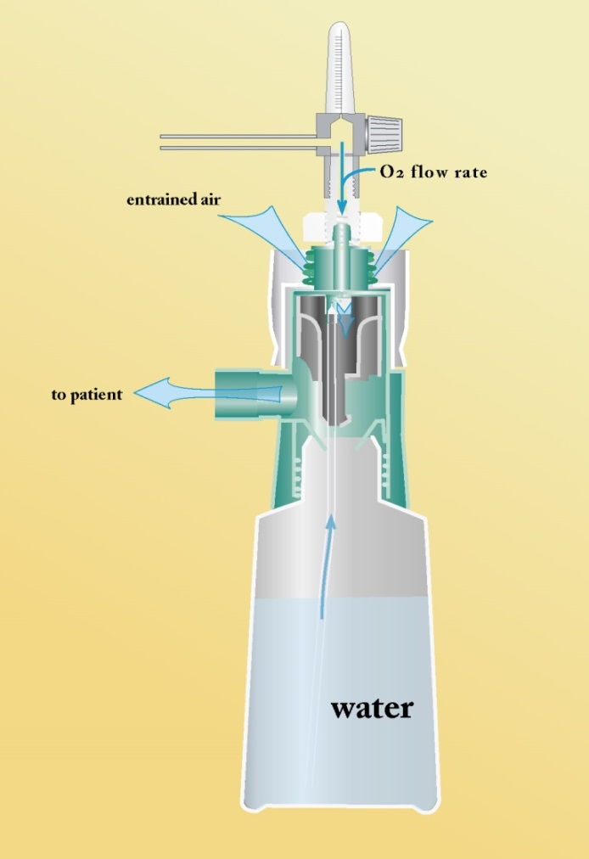
How does it work?

Slide 8
Features and Benefits
Tamper resistant
oxygen control setting

Slide 9
Low Operating Noise
When delivering 35% oxygen Intersurgical 50% quieter:
Intersurgical 7dB
Medicaid 13dB
Kendall 14dB
Hudson 17dB
PMP - Allegiance 17dB

Slide 10
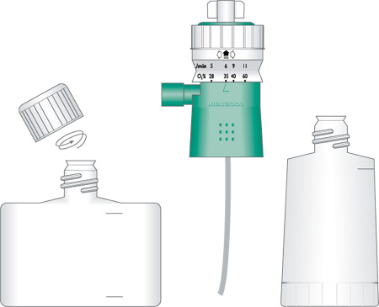
Compatible with sterile water bottles
AquaMist universal thread fitting fits the following sterile water bottles
Baxter
Braun
Fresenius
MPV Truma

Slide 11
Particle size
MMD between 3.5-5 microns at all oxygen settings
At 40% oxygen
Intersurgical 3.6 MMD
Medicaid 4.2 MMD
Hudson 2.8 MMD

Slide 12
Product Available
Variety of options

Slide 13
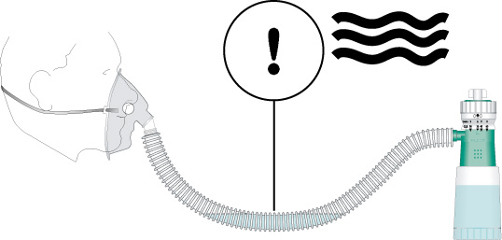
Cautions
Ensure excessive water does not collect in the Flextube

Slide 14
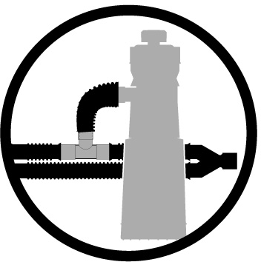
Caution
The AquaMist cannot be used in-line

Slide 15
Summary
Low operating noise
Accurate oxygen delivery
Tamper resistant oxygen control setting
Compatible with sterile water bottles
Good humidification output
Five options

